Slide 1

Agro Probe All-in-one sensor
By
B.SIDDARTHA

Slide 2

Problem
Solution
Poor pre-Crop Analysis , inadequate attention to the Crop, Irregular Harvesting , Poor Soil Quality measures and pests are the main problems faced by all the farmers.
Starting from Pre-Crop Analysis to harvesting,
Our all-in-one Agro Probe will stand by it's
purpose and benefits Farmers where they
could afford and fittingly easy to use.

Slide 3
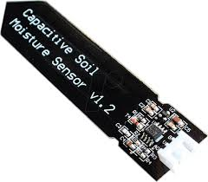
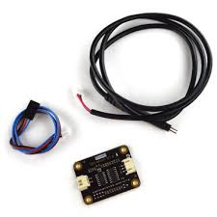
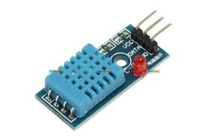
WORKING
*esp32 micro controler
*Soil Moisture Sensor
*TDS Sensor
*aggrigation of sensors data to web and mobile app (real time)
*data uploaded to web can view by farmers to such that they can estimate the crop porduction.

Slide 4
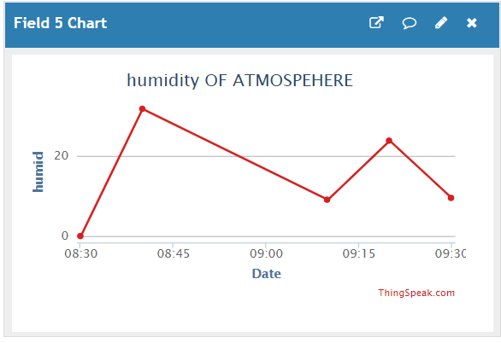
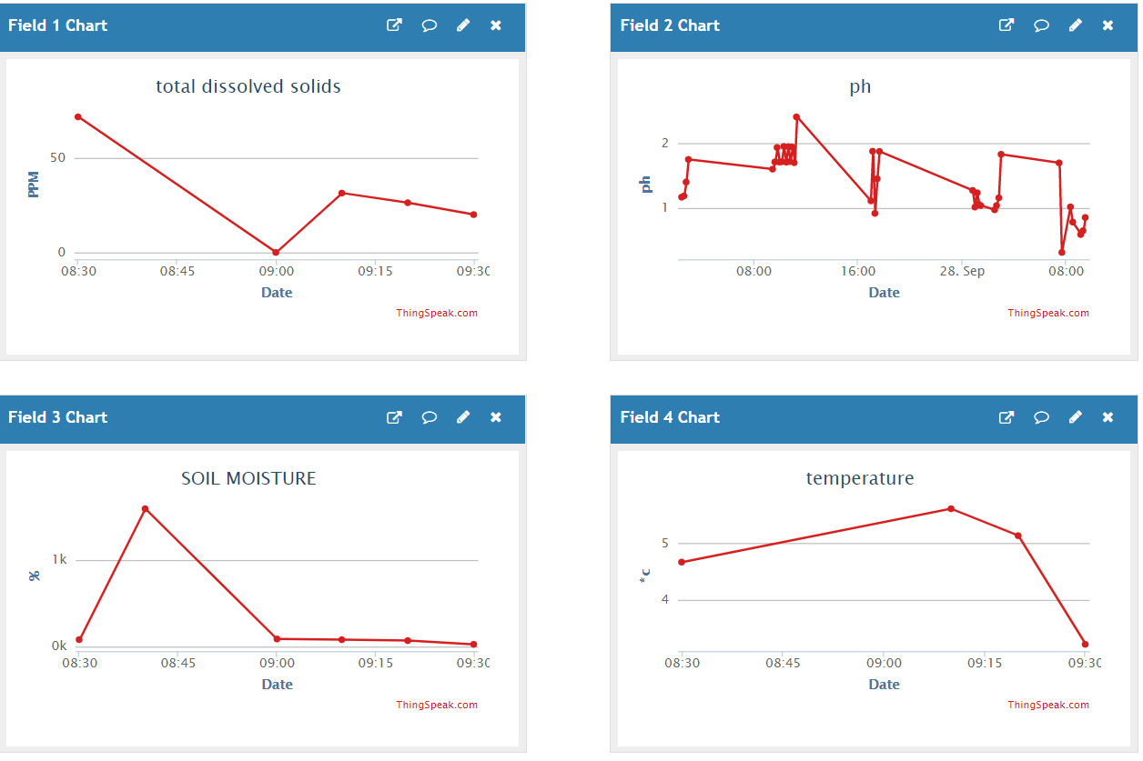

Web upload

Slide 5
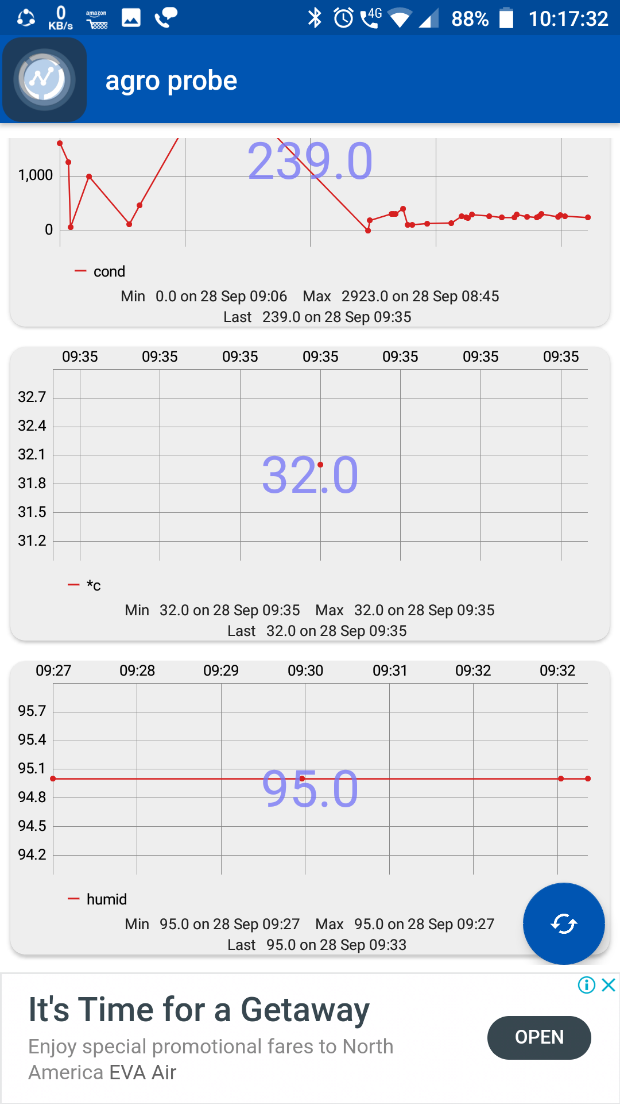
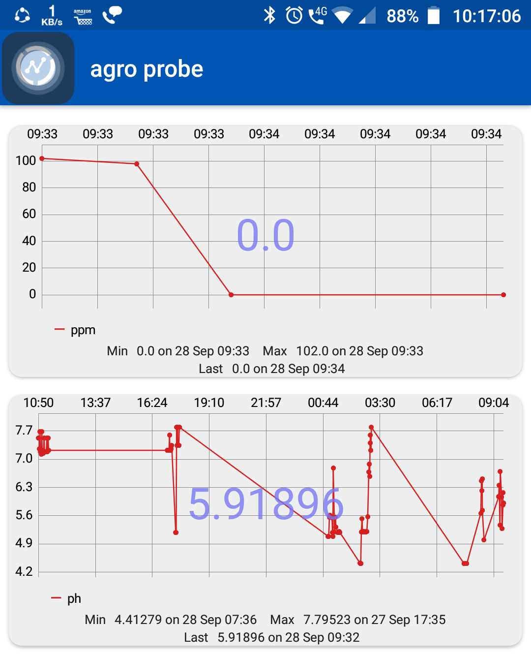
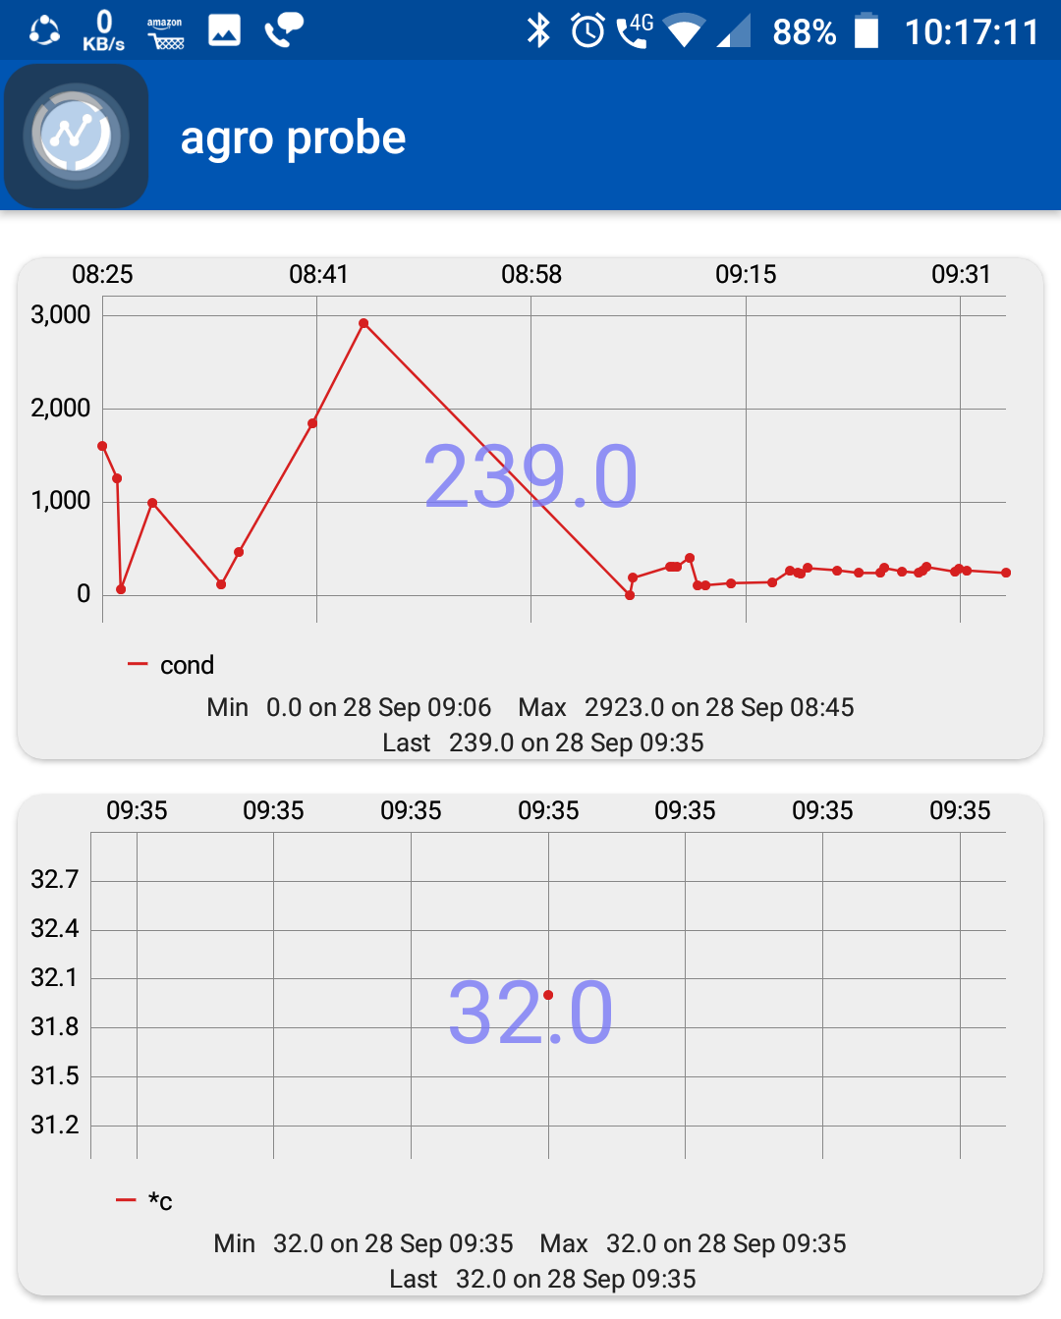
Mobile upload

Slide 6
ADVANTAGES
*REAL TIME UPDATE OF AGRICULTURE FEILD
*PRE CROP ESIMATION
*NUTRESNING THE FEILD INTIME

Slide 7
Thank You
B.SIDDARTHA
Innovation cell
Acharya nagarjuna university college of engineering and technology

